Slide 1

Comparison between ingress controllers and methods to secure applications in k3s cluster based on authentication and automated certificates
Presenter → Dikshita Kalita
Supervisor → Prof. Dr Martin Leischner
Mentor → Richard Clauß

Slide 2
Agenda
03
01
Research Questions
Security in Kubernetes
02
Ingress controllers
Introduction
Users
Introduction
Access Control
Types
Pipeline
Comparison
AuthN Strategies
Preference
AuthZ Modules
OIDC
04
Demos
AuthN Protocol Comparison
Dikshita Kalita | K3s ingress and security

Slide 3
Research Questions
01
Basic properties of underlying implementations
What are the principal point of differences between Traefik, HaProxy and Nginx?
2. Security in kubernetes
Analyse best modes to authenticate users accessing the cluster and its resources.
Compare their key differences based on scenarios.
Dikshita Kalita | K3s ingress and security

Slide 4

02
Ingress controllers
Dikshita Kalita | K3s ingress and security

Slide 5
02
Ingress controllers | Introduction | 1
Object that allows access to the Kubernetes services from outside of the cluster.
Controls how the external users should access the services running in a kubernetes cluster typically via HTTP/HTTPS through a single externally reachable IP address.
Operates at the application layer of the network stack.
Continued …
Dikshita Kalita | K3s ingress and security

Slide 6
02
Ingress controllers | Types & Comparison
Cloud-based
Types
2. Open-source
Dikshita Kalita | K3s ingress and security

Slide 7
02
Ingress controllers | Types & Comparison
 | Nginx | Ha-proxy | Traefik
Build on | nginx/nginx plus | haproxy | traefik
Protocols supported | HTTP(s) HTTP2 TCP/UDP | HTTP(s) HTTP2 TCP+TLS | HTTP(s) HTTP2 TCP+TLS
Traffic routing logic | Host Path Header Method Query params | Host Path | Host Path Headers Query Methods Path prefix
Dikshita Kalita | K3s ingress and security

Slide 8

02
Ingress controllers | Preference
Best TLS termination and header-based routing
Automatically enables HTTP2 and is better
Built-in Lets Encrypt and supports automatic certificate renewal
High performance and stability
Dikshita Kalita | K3s ingress and security

Slide 9

03
Security in Kubernetes
Dikshita Kalita | K3s ingress and security

Slide 10
03
Security in Kubernetes | Introduction | 1
Image registry
UI
Node 1
Master Node
Node 2
API
CLI
Node 3
.
.
.
Node n
Fig: Architecture in bigger picture
Dikshita Kalita | K3s ingress and security

Slide 11

03
Security in Kubernetes | Users
Humans
Service Accounts
Dikshita Kalita | K3s ingress and security

Slide 12


03
Security in Kubernetes | User 1- Humans
Kubernetes does not have
RELIES on a variety of techniques to delegate that
User, profile database / lookup table to store usernames, passwords to store usernames, passwords
Instead
For human users
i.e.
NO API calls to create user
Dikshita Kalita | K3s ingress and security

Slide 13

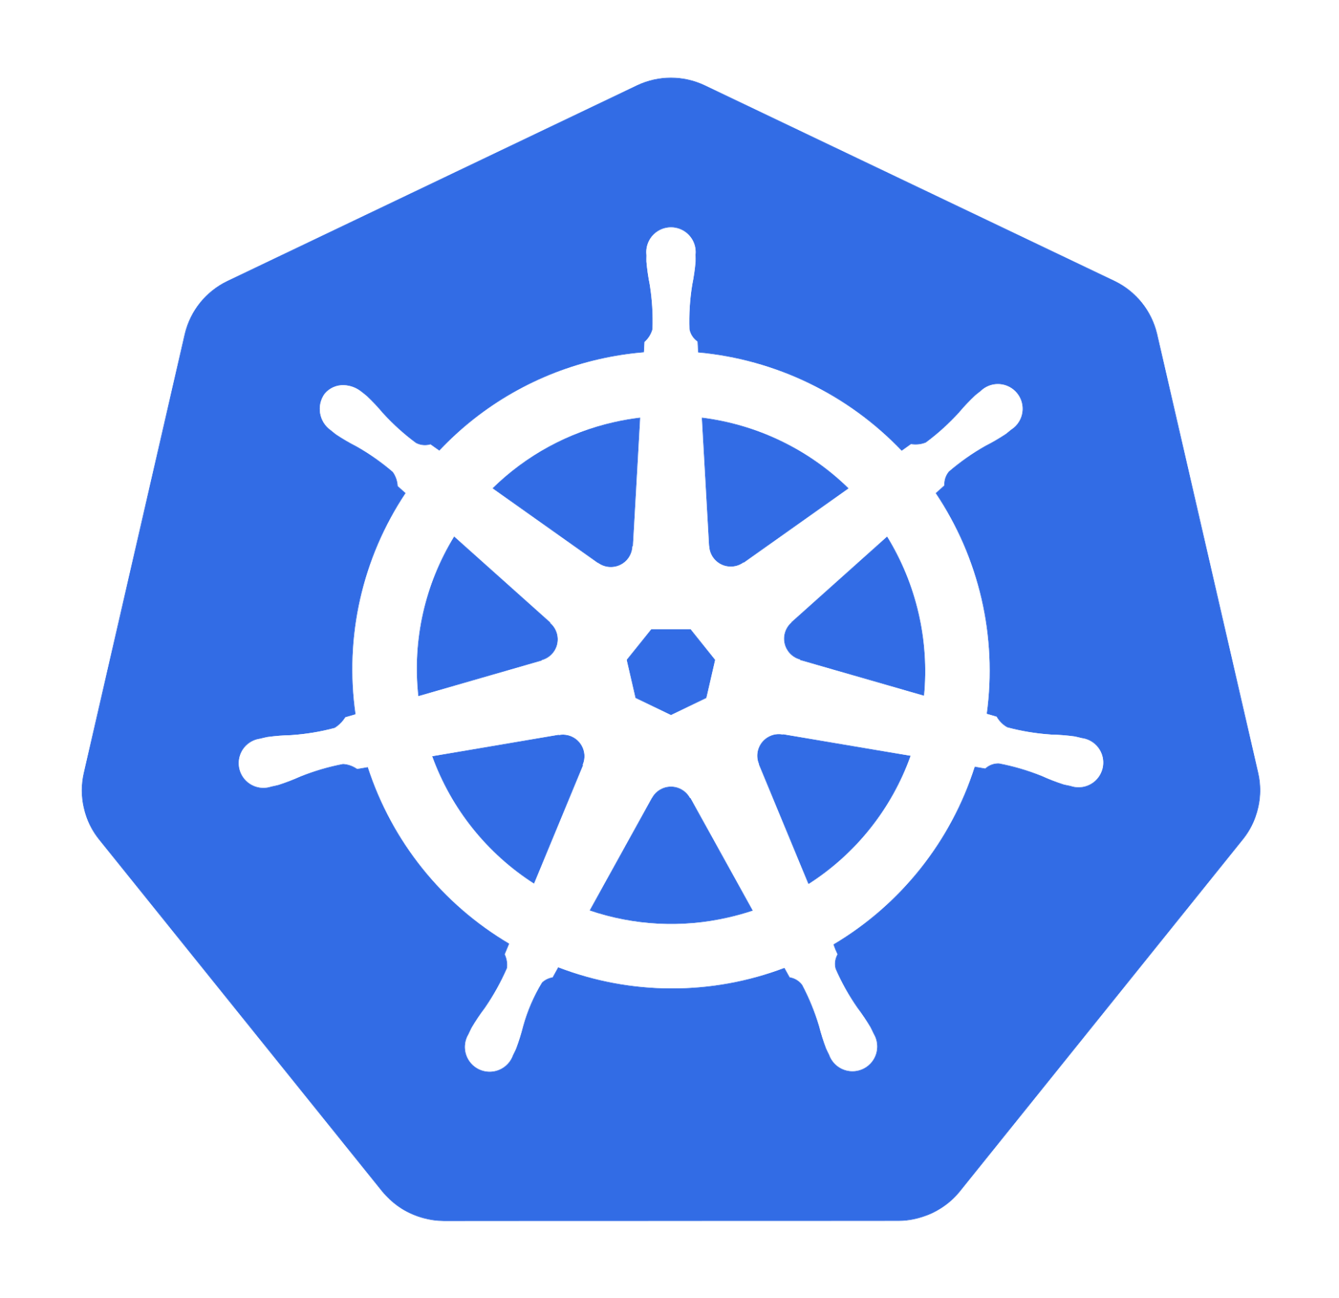

03
Security in Kubernetes | User 2- Pods
Service Account / SA is
1. Internal representation of a set of credentials that are typically stored as Secrets.
Accesses
Through
Service Accounts
2. Pods uses this SA to authenticate when they talk to internal API endpoint
3. By default, SA have no access permissions but can be configured using RBAC to give them access permission and role-based control so they can query and manipulate
Dikshita Kalita | K3s ingress and security

Slide 14
03
Security in Kubernetes | ServiceAccount
Very useful if we have an automatized application set-up in the cluster to deploy the pods after its build up
2. Create a Role:
k3s kubectl apply -f default-role.yaml
3. Create a RoleBinding:
k3s kubectl apply -f role-binding.yaml
Dikshita Kalita | K3s ingress and security

Slide 15


03
Security in Kubernetes | Access Control | 1
Kubernetes is not a security platform
Native tooling to handle most security-related tasks
Access Control
Detecting vulnerabilities within applications
Cluster
Monitoring for attacks / breaches
Kube API
Dikshita Kalita | K3s ingress and security

Slide 16
03
Security in Kubernetes | Access Control | 2
Methods
TLS
Authentication
Authorization
Admission Control
Dikshita Kalita | K3s ingress and security

Slide 17





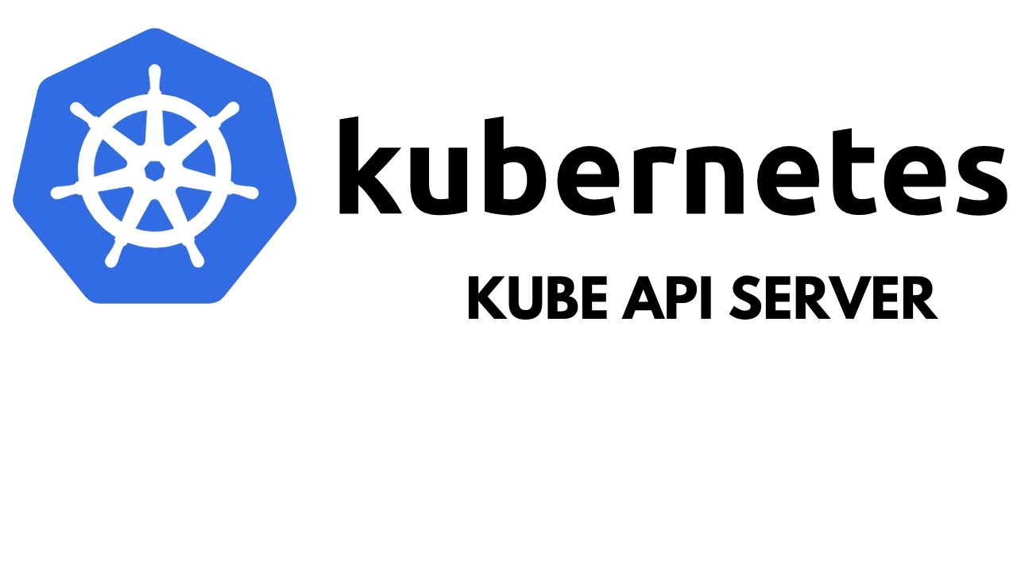
03
Security in Kubernetes | Security Pipeline
Human user
Kubernetes object (s)
Authentication
2. Authorization
3. Admission Control
Pod/ServiceAccount
Fig: Kubernetes security pipeline, Source: Click here
Continued …
Dikshita Kalita | K3s ingress and security

Slide 18
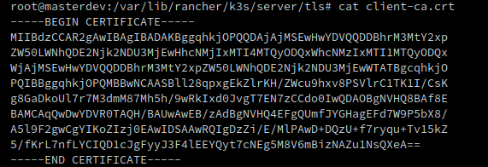
03
Security in Kubernetes | AuthN Strategies
Basic Authentication
X509 Client Certificates
Tokens
Pass a CSV with the following:
<password>,<username>,<UID>,”<group1, group2>”
<password>,<username>,<UID>,”<group2, group4>”
OpenID Connect
Insecure
Not scalable
Long-lived and can’t be revoked effectively
Makes it hard to use groups with RBAC
Dikshita Kalita | K3s ingress and security

Slide 19

03
Security in Kubernetes | AuthZ Modules
1. It evaluates attributes or characteristics in order to determine the access
AlwaysAllow
Not for production but for specified use-case
2. AlwaysDeny
2. The administrator defines a set of user authorization policies into a file with one JSON per line format.
3. Node
Using this node or kubelet would talk to API server
Any modification in the file requires API server to be restarted.
4. Attribute-Based Access Control(ABAC)
1. Here we define Roles and with these roles a user can access kubernetes objects
5. Role-based Access Control (RBAC)
6. Webhook
We can connect multiple webhooks for authorization
Dikshita Kalita | K3s ingress and security

Slide 20

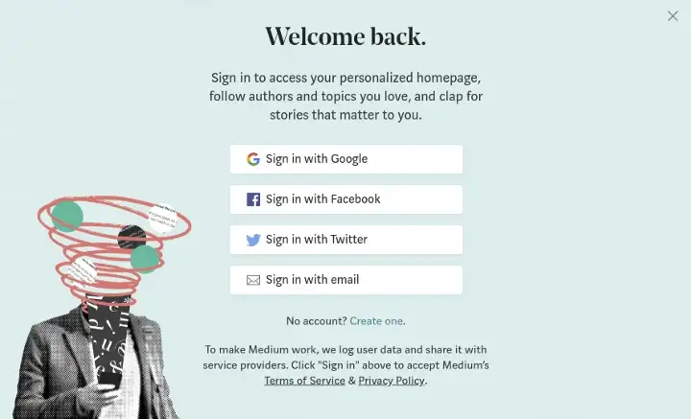


03
Security in Kubernetes | Auth | OIDC
Widely accepted as a solution to authentication of users on web services
2. Easy to use because it sits on top of existing technology OAuth2.0
3. Typical use-case: Identity Federation
Simple identity layer for Authentication
Standard protocol for Authorization
Dikshita Kalita | K3s ingress and security

Slide 21











03
Security in Kubernetes | Auth | OIDC
User
Identity Provider
kubectl
API Server
Login to IDP
Provide access_token,id_token, & refresh_token
Call Kubectl with --token being the id_token OR add tokens to .kube/config
Authorization: Bearer
Is JWT signature valid?
Has the JWT expired? (iat+exp)
User authorized?
Authorized: Perform action and return result
Return result
User
Identity Provider
kubectl
API Server
Dikshita Kalita | K3s ingress and security

Slide 22

03
Security in Kubernetes | OIDC | IdP
A system entity that creates, maintains, and manages identity information for users and also provides authentication services to relying applications.
Does Kubernetes provide an OpenID Connect Identity Provider ?
Solution ?
Dikshita Kalita | K3s ingress and security

Slide 23
03
Security in Kubernetes | OIDC | IdP
We can
Use an existing public OpenID Connect IdP
2. Run our own Identity Provider
Google
Keycloak
Microsoft
Dex
Amazon
CloudFoundry User Account and Authentication
Okta
Tremolo Security's OpenUnison
PayPal
SalesForce
PhantAuth
Github
Dikshita Kalita | K3s ingress and security

Slide 24


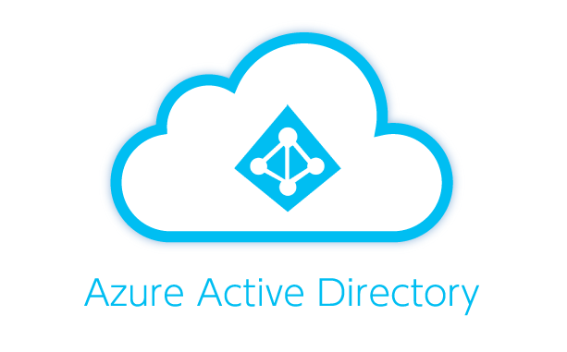


03
Security in Kubernetes | OIDC | IdP
Keycloak
Dex
Complex to operate since it needs standalone database
Simple and easy to set up
Scenario:
Scenario:
Existing IDP
DEX
Keycloak
IDP
OIDC interface
Dikshita Kalita | K3s ingress and security

Slide 25
03
Security in Kubernetes | Auth | Comparison
 | Kerberos | Lightweight Directory Access Protocol | LDAP | OAuth2.0 | Security Assertion Markup Language | SAML | OIDC
Function | Aids in network authentication | Used for determining any individuals, organizations, and other devices during a network regardless of being on public or corporate internet. It is practiced as Directories-as-a-Service and is the grounds for Microsoft building Activity Directory. | Authorization framework that grants limited access to the user on its account through an HTTP service | XML-based authentication data format which provides authorization between identity provider(Google, AWS, Microsoft Active Directory or Azure) and service provider(Salesforce and other CRM solutions). | Authentication protocol that has API-centered architecture that uses JSON tokens (ID token) and is currently supported by many popular web services, including Google, Paypal, Microsoft and Amazon.
Pros | 1. Supports many OS 2. Authentication key is shared much efficiently than public sharing | 1. Automated protocol which makes it modernize easily 2. Supports existing technologies and allows multiple directories | 1. Simple protocol and is easy to implement 2. Provides server-side authorization of code | 1. Reduced the administrative costs for the end-users 2. Provides SSO for authenticating across service providers | 1. Fast and easy implementation 2. Lightweight and more performance-friendly than SAML 3. Provides a frictionless user experience for mobile and single-page web applications.
Cons | 1. Used only to authenticate clients and services used by them 2. Vulnerable to soft or weak passwords | 1. Directory servers are required to be LDAP obedient for deployment 2. No 2FA 3. Not scalable | 1. Vulnerable to manage different sets of code | 1. Dependent on the identity provider | 1. Still new and evolving and lacks some high-security features that are needed by certain sectors, such as the banking industry.
Dikshita Kalita | K3s ingress and security

Slide 26

03
Security in Kubernetes | Demos
Dikshita Kalita | K3s ingress and security

Slide 27
Resources
https://kubernetes.io/docs/reference/access-authn-authz/authentication/
https://www.tremolosecurity.com/post/kubernetes-dont-use-certificates-for-authentication
https://cloudinfrastructureservices.co.uk/oauth2-vs-openid-whats-the-difference/
https://sysdig.com/learn-cloud-native/kubernetes-security/kubernetes-rbac/
https://www.geeksforgeeks.org/types-of-authentication-protocols/
https://www.strongdm.com/blog/oidc-vs-saml#:~:text=OIDC%3A%20What's%20the%20Difference%3F,to%20obtain%20the%20security%20token.
https://www.varonis.com/blog/what-is-oauth
https://dinika-15.medium.com/identity-federation-a-brief-introduction-f2f823f8795a
https://en.wikipedia.org/wiki/Identity_provider
https://metal-k8s.readthedocs.io/en/latest/developer/architecture/authentication.html
https://medium.com/@sct10876/keycloak-vs-dex-71f7fab29919

Slide 28

Note of gesture
Thank you for your attention and patience

